Slide 1
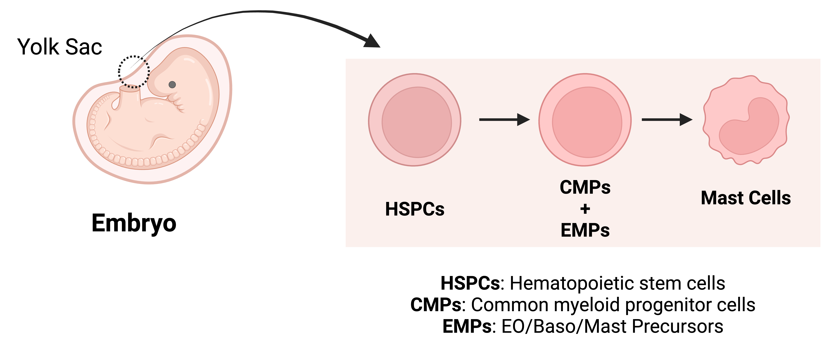
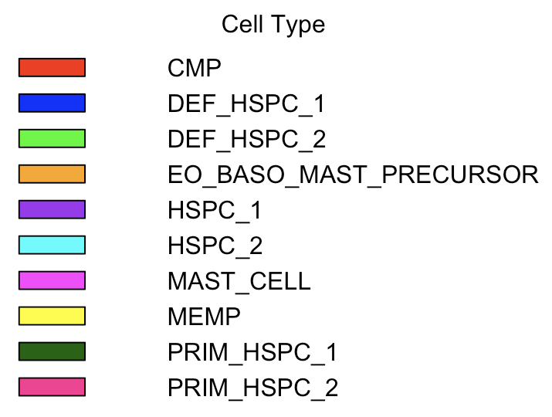
A
C
D
Ratio of cells expressed In Each Stage of Development
B
% of Cells
Stage of Development

Slide 3
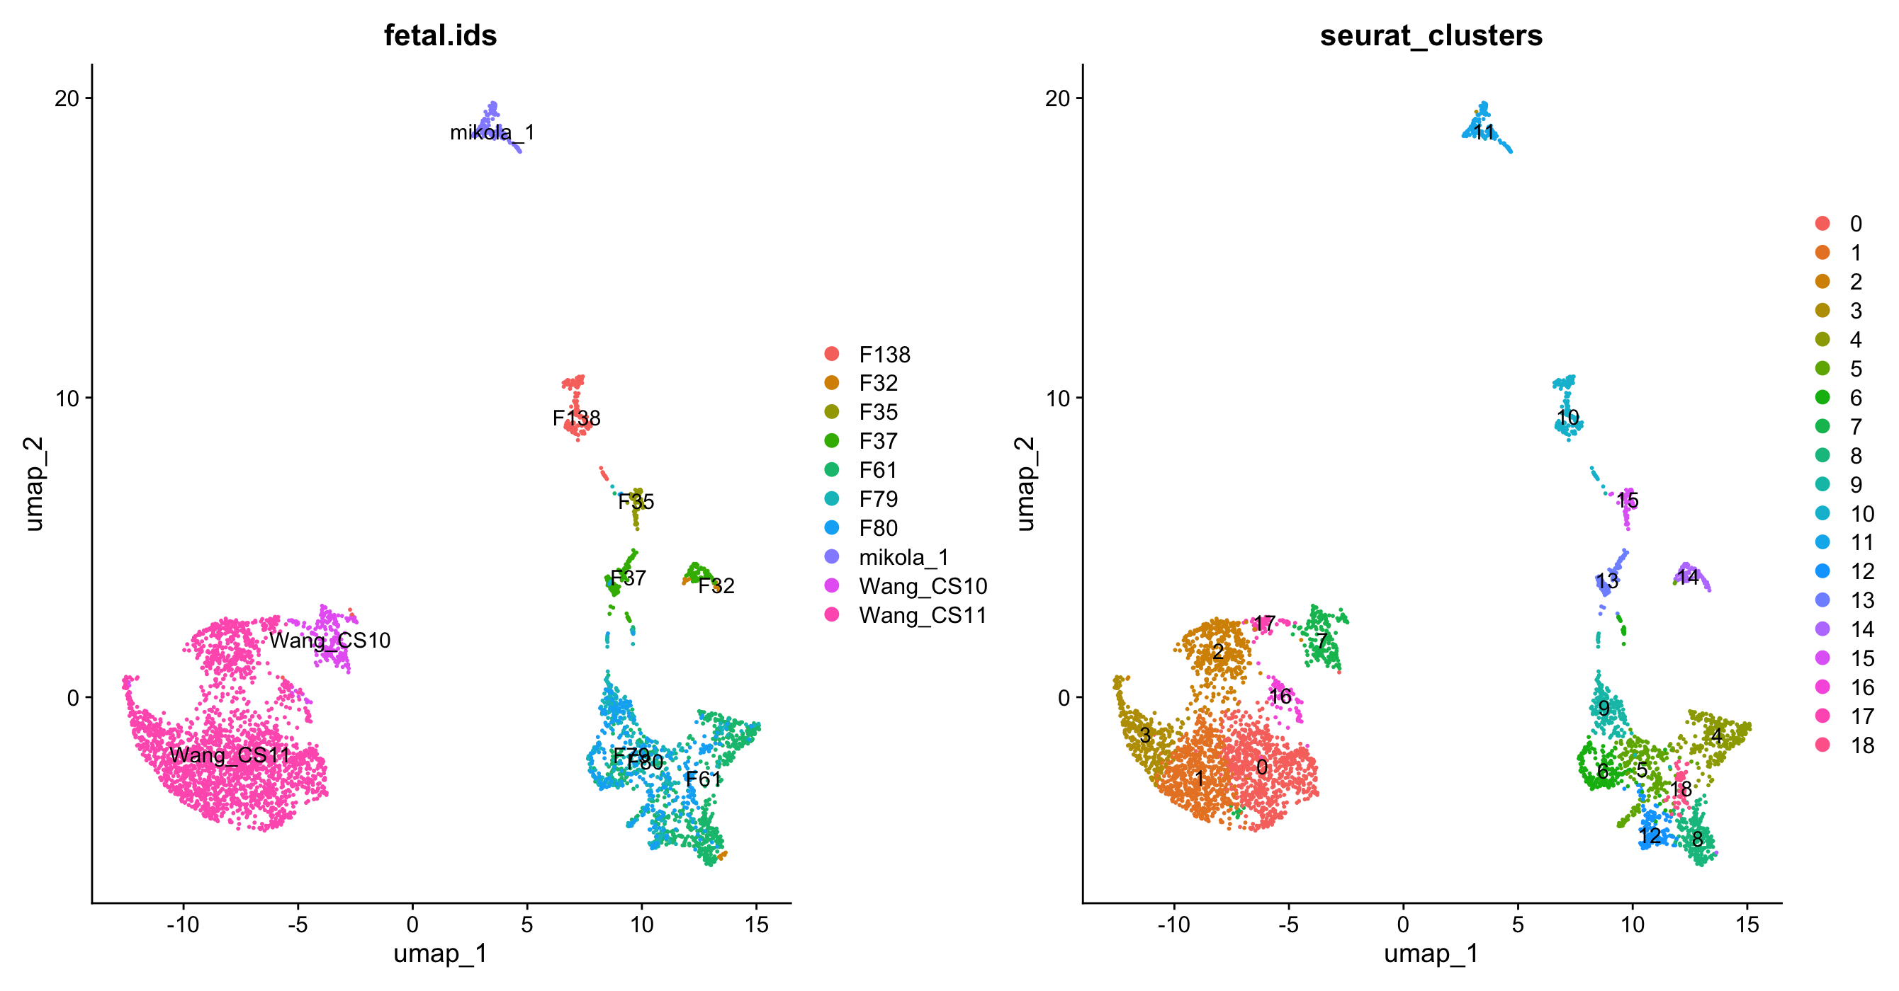
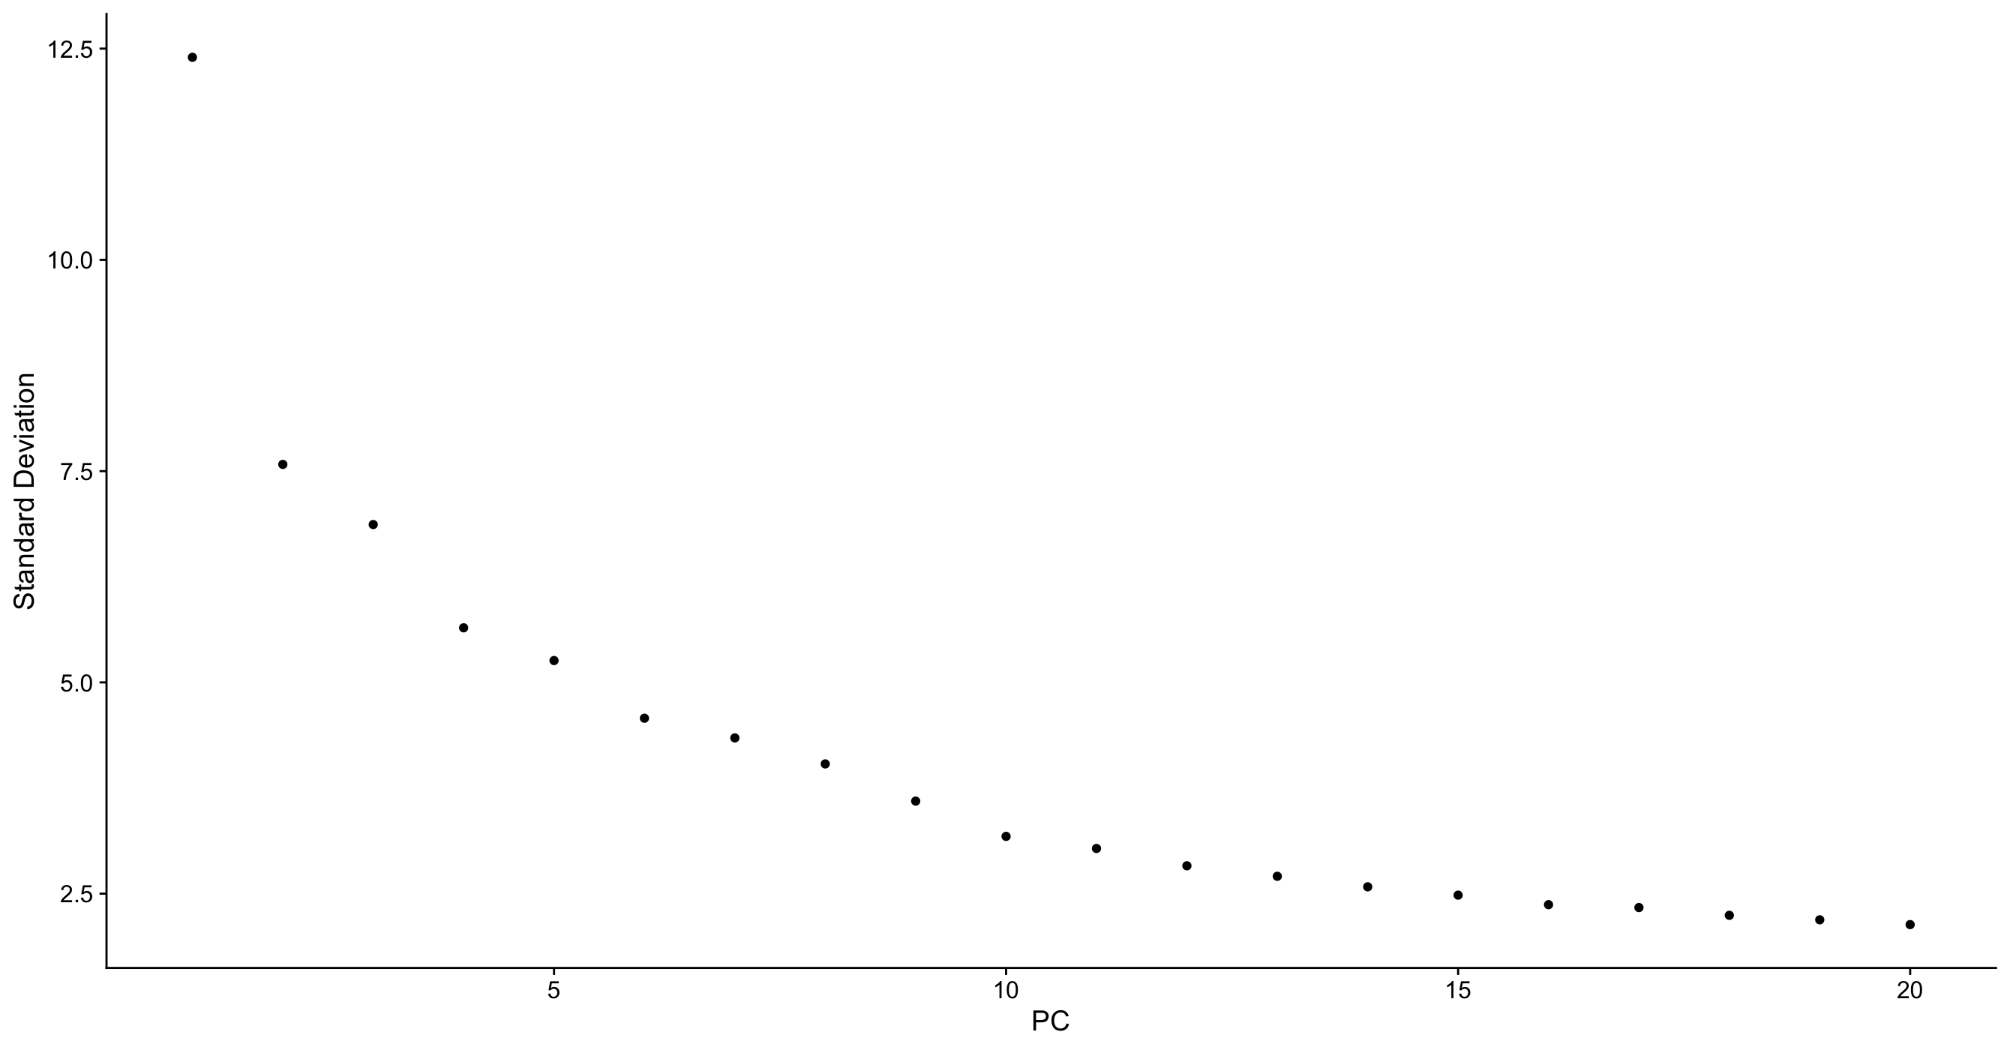
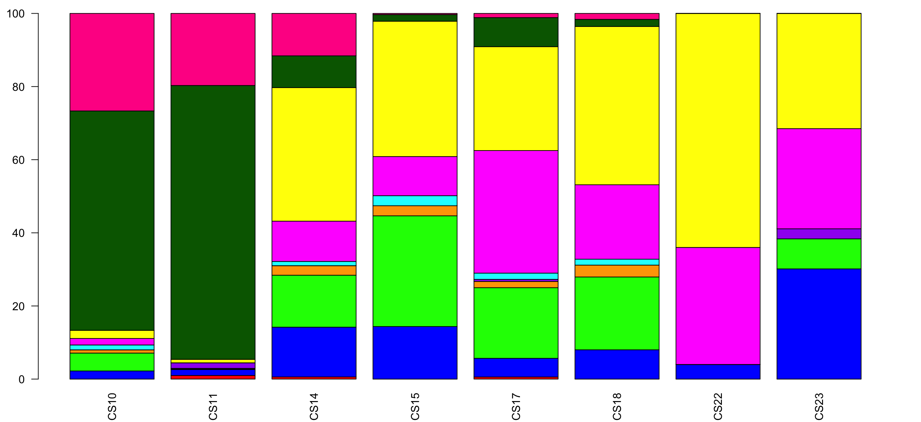
A
C
D
Ratio of cells expressed In Each Stage of Development
B
% of Cells
Stage of Development

Slide 4
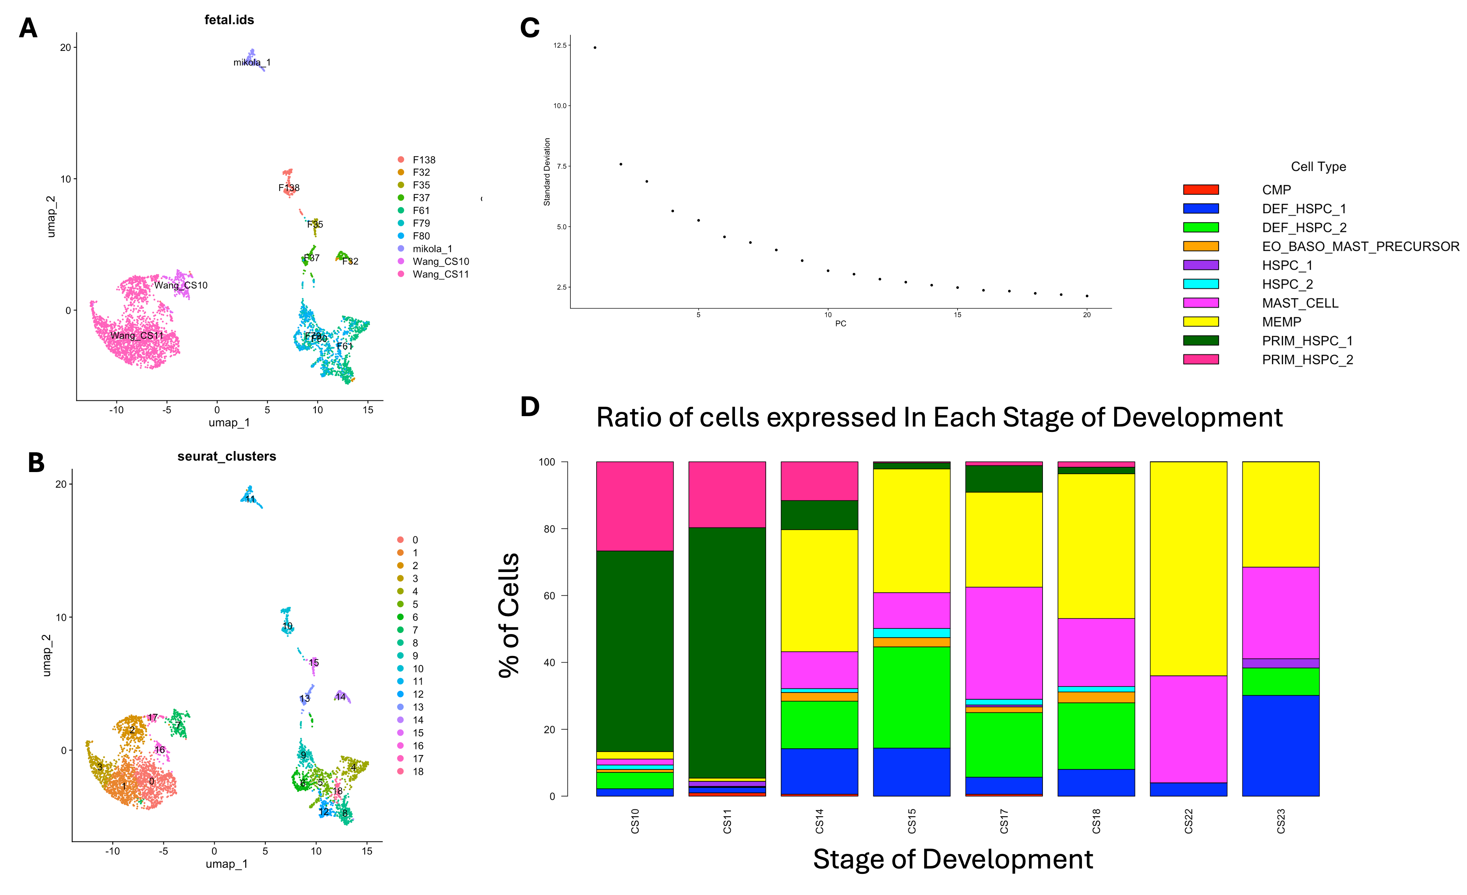
Supplemental Figure 1:

Slide 5
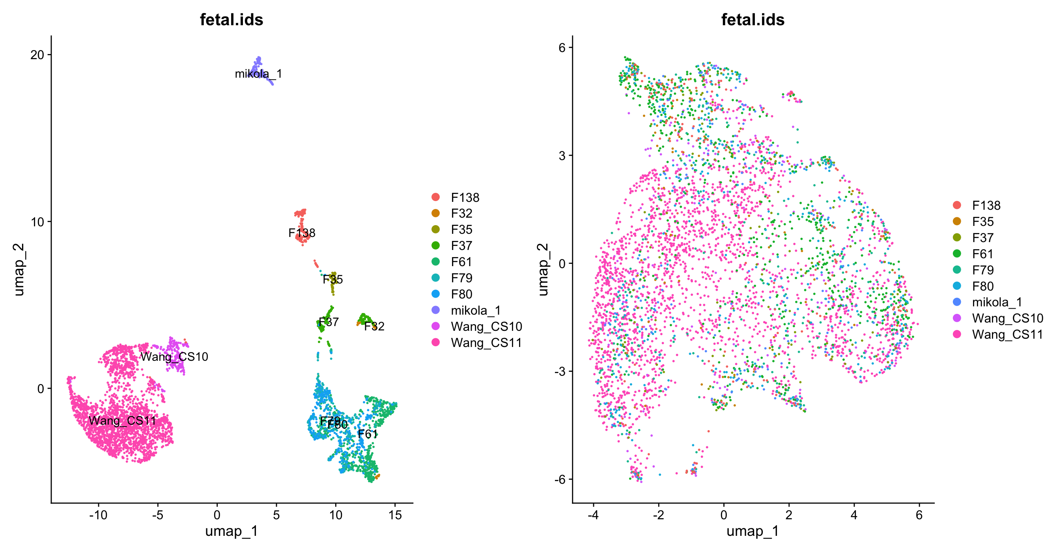
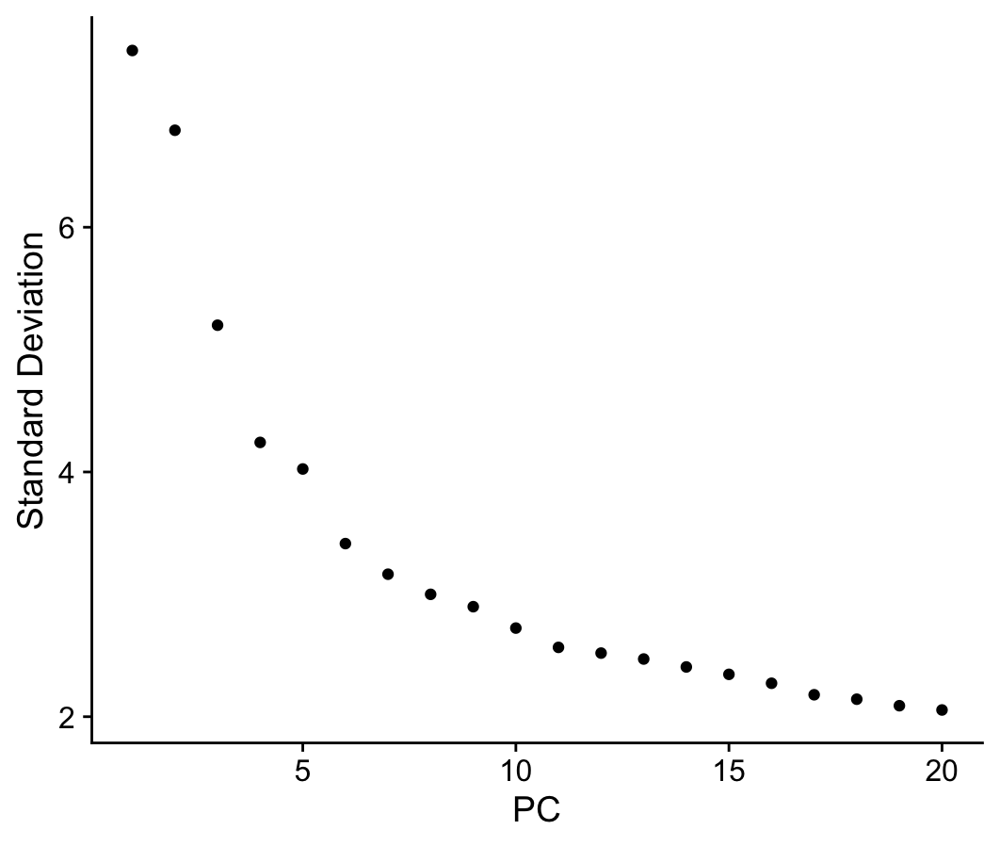
A
B
C

Slide 7
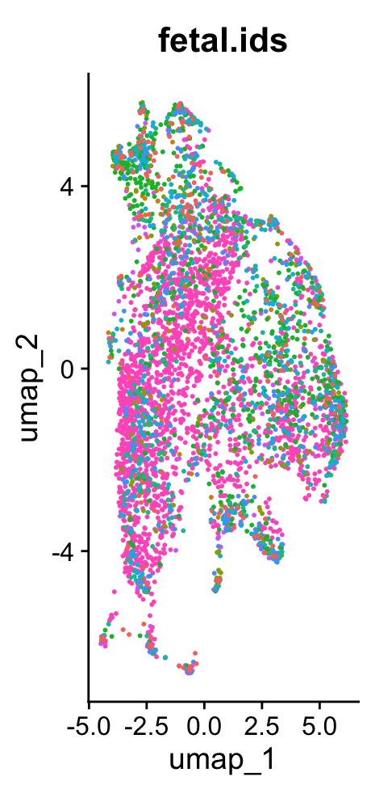
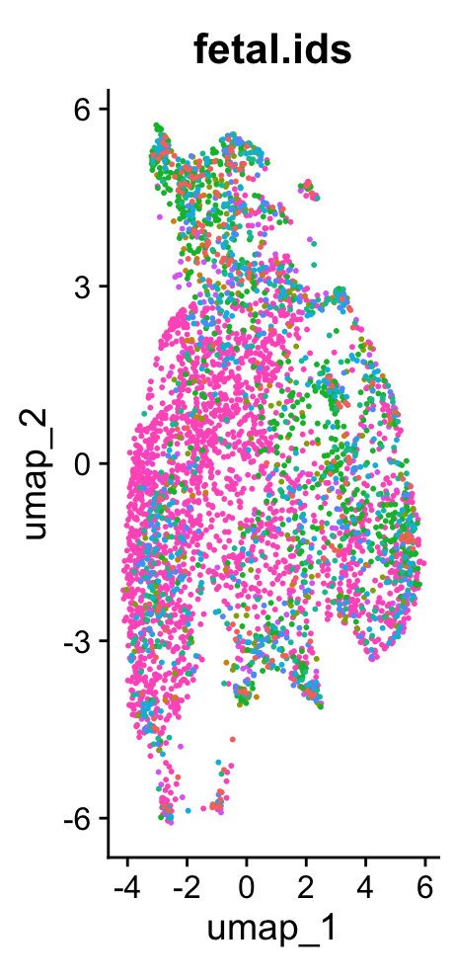
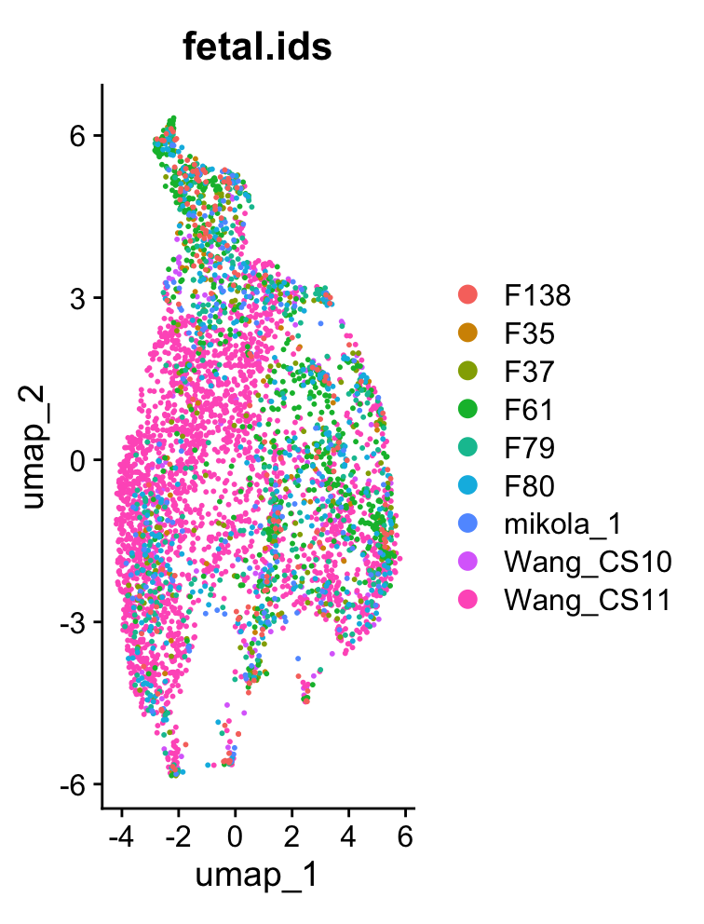
A
B
C
k.Weight = 20
k.Weight = 50
k.Weight = 70

Slide 9
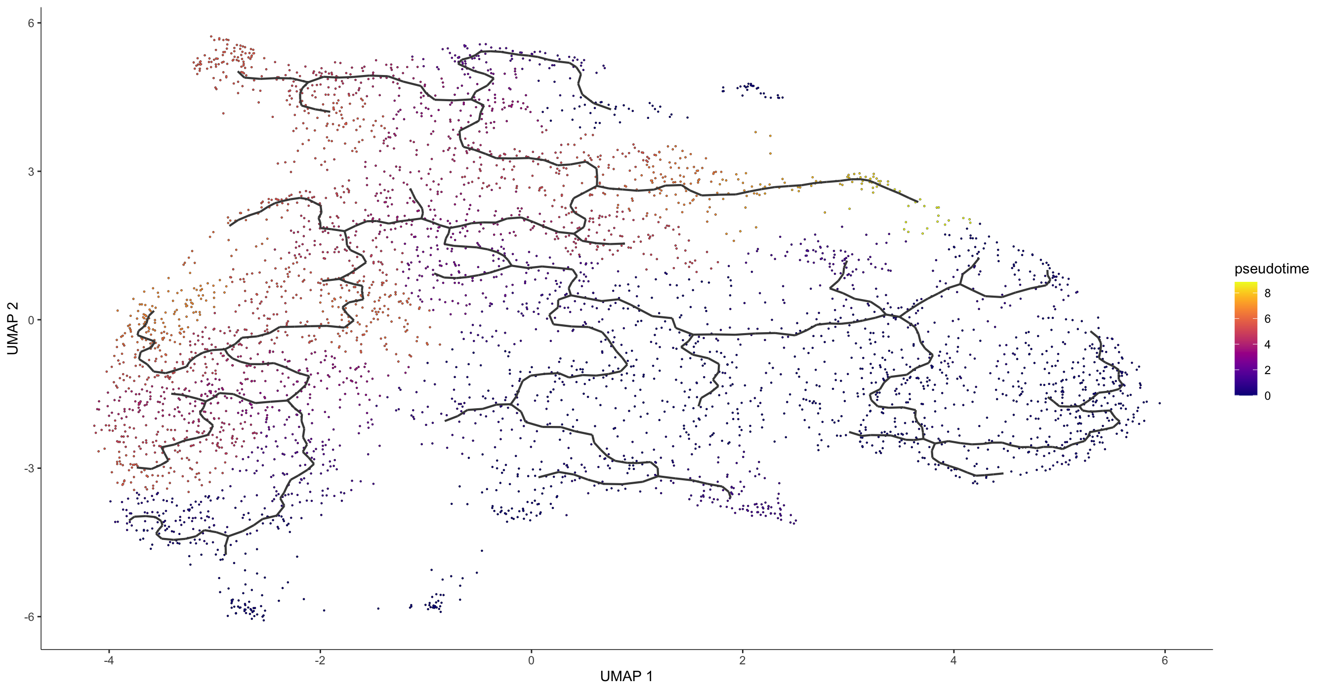
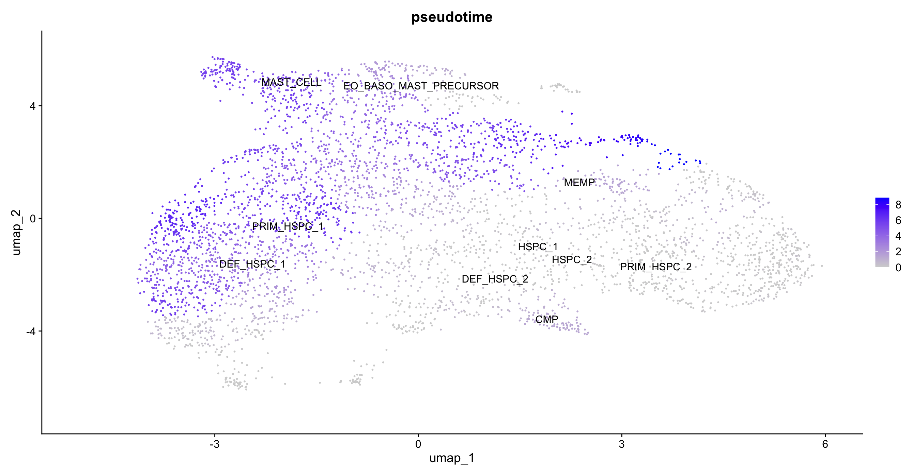
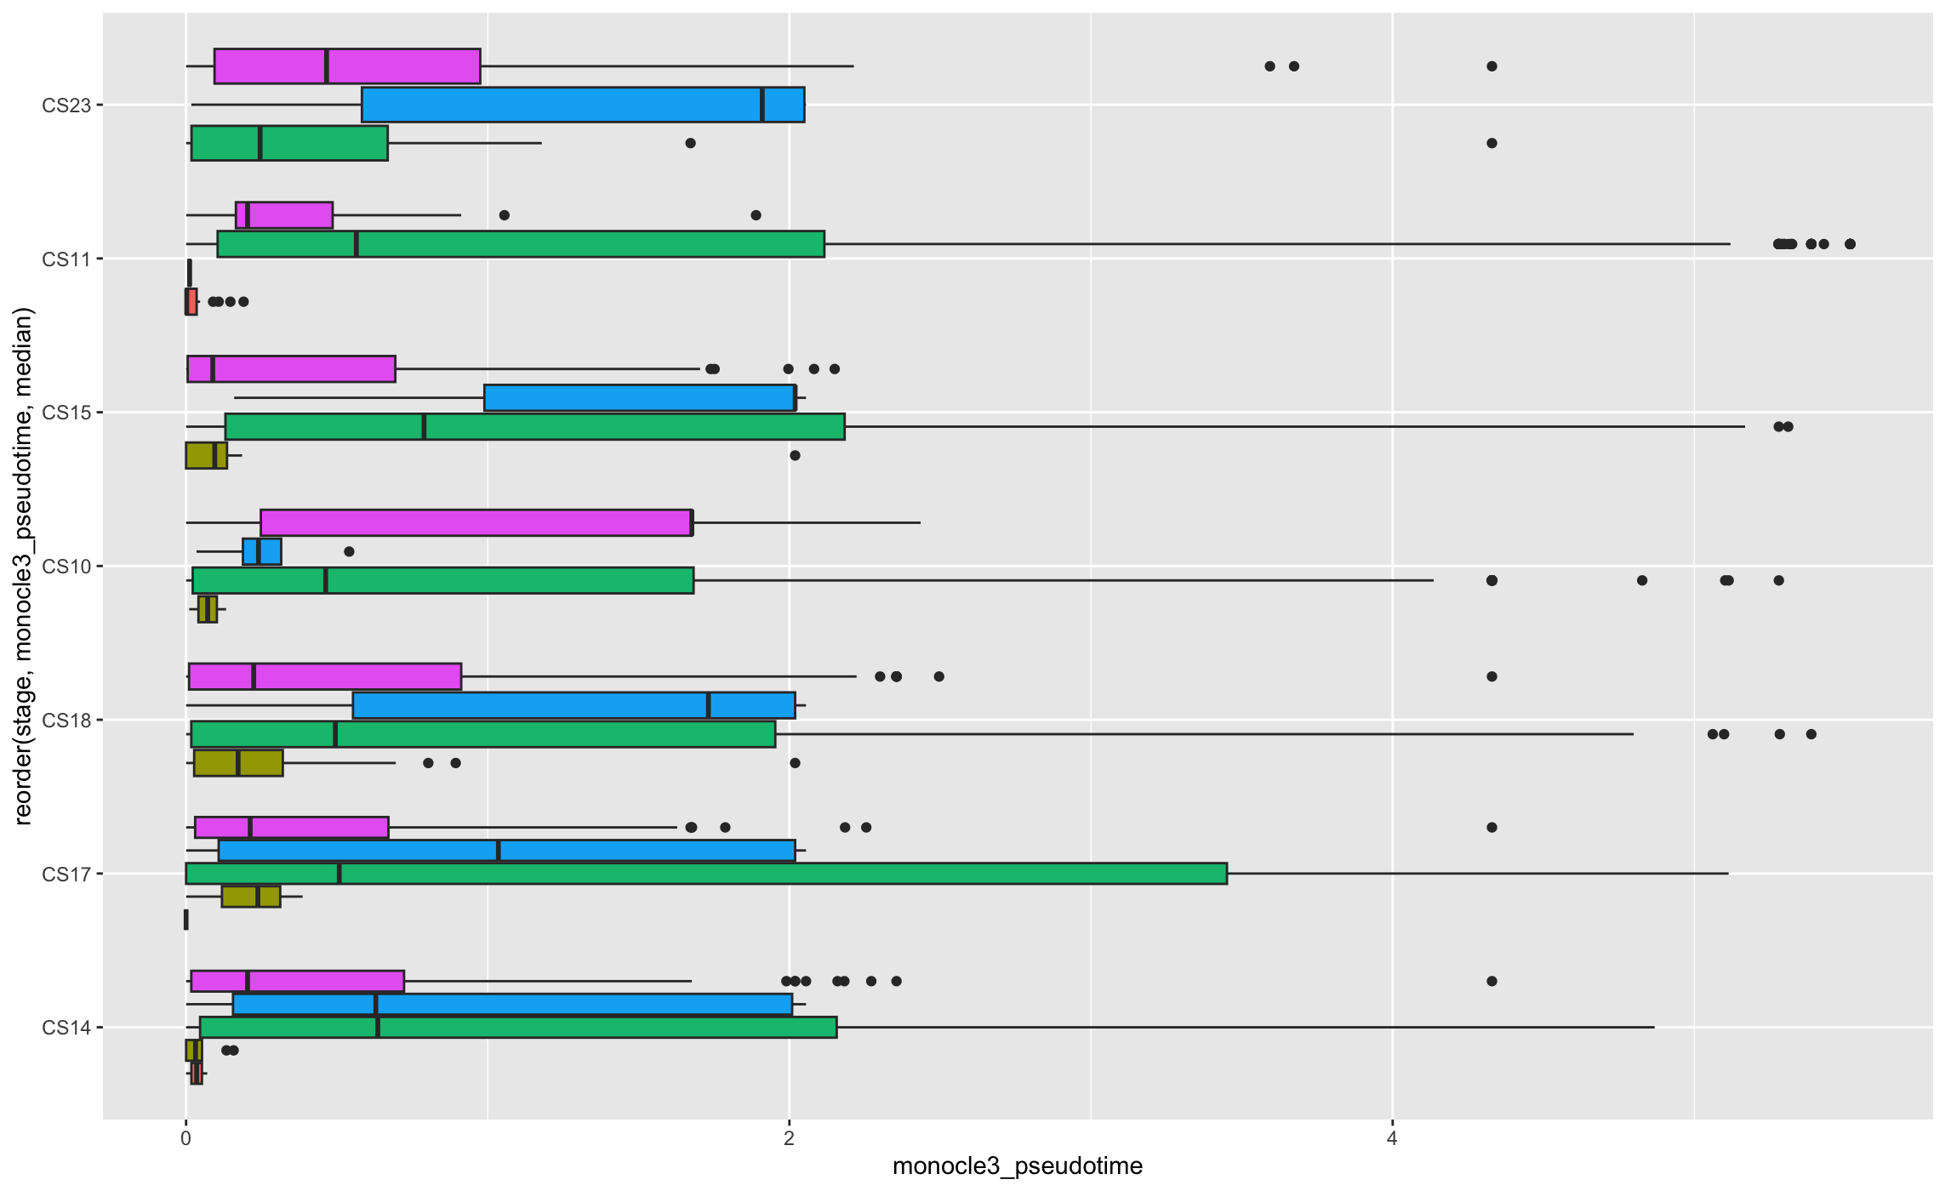
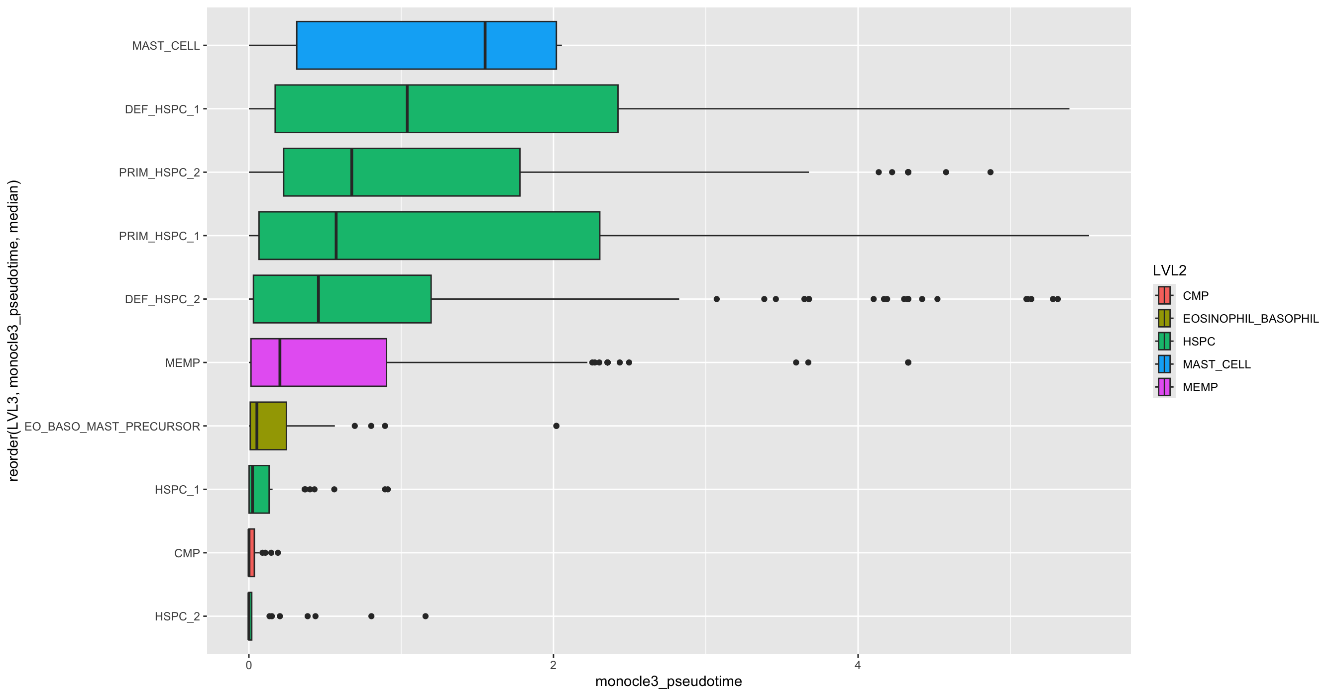
A
B
C
D

Slide 11
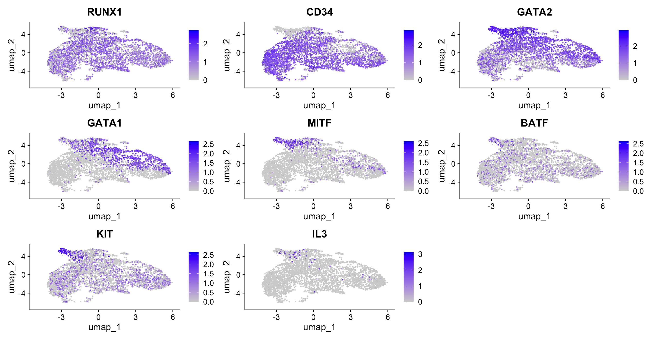
A
RUNX1 =
CD34 =
GATA1 =
GATA2 =
MITF =
BATF =
KIT =

Slide 13
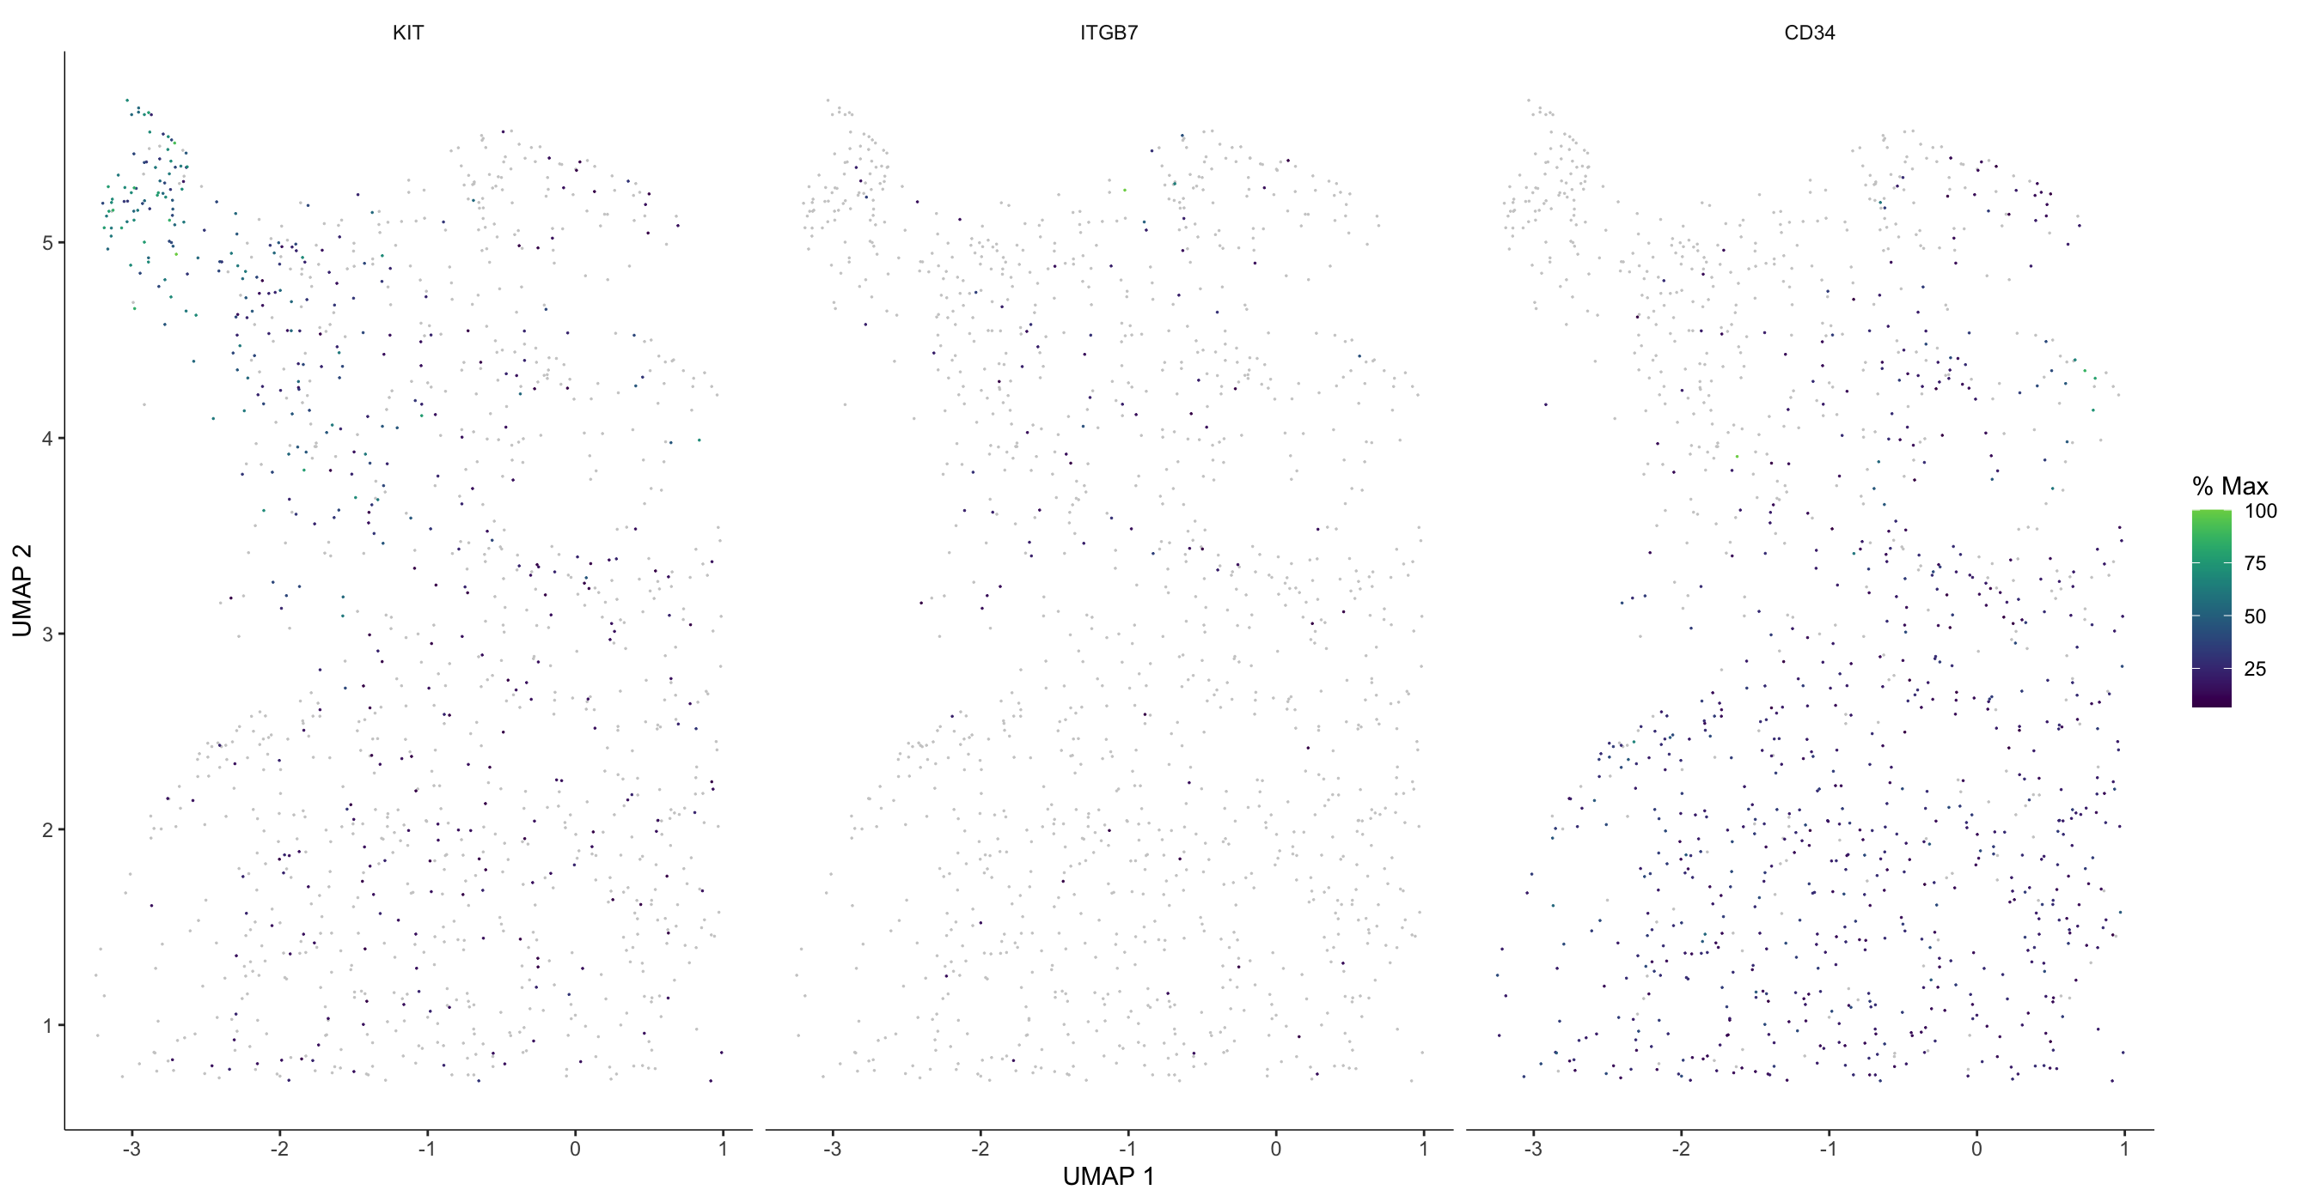
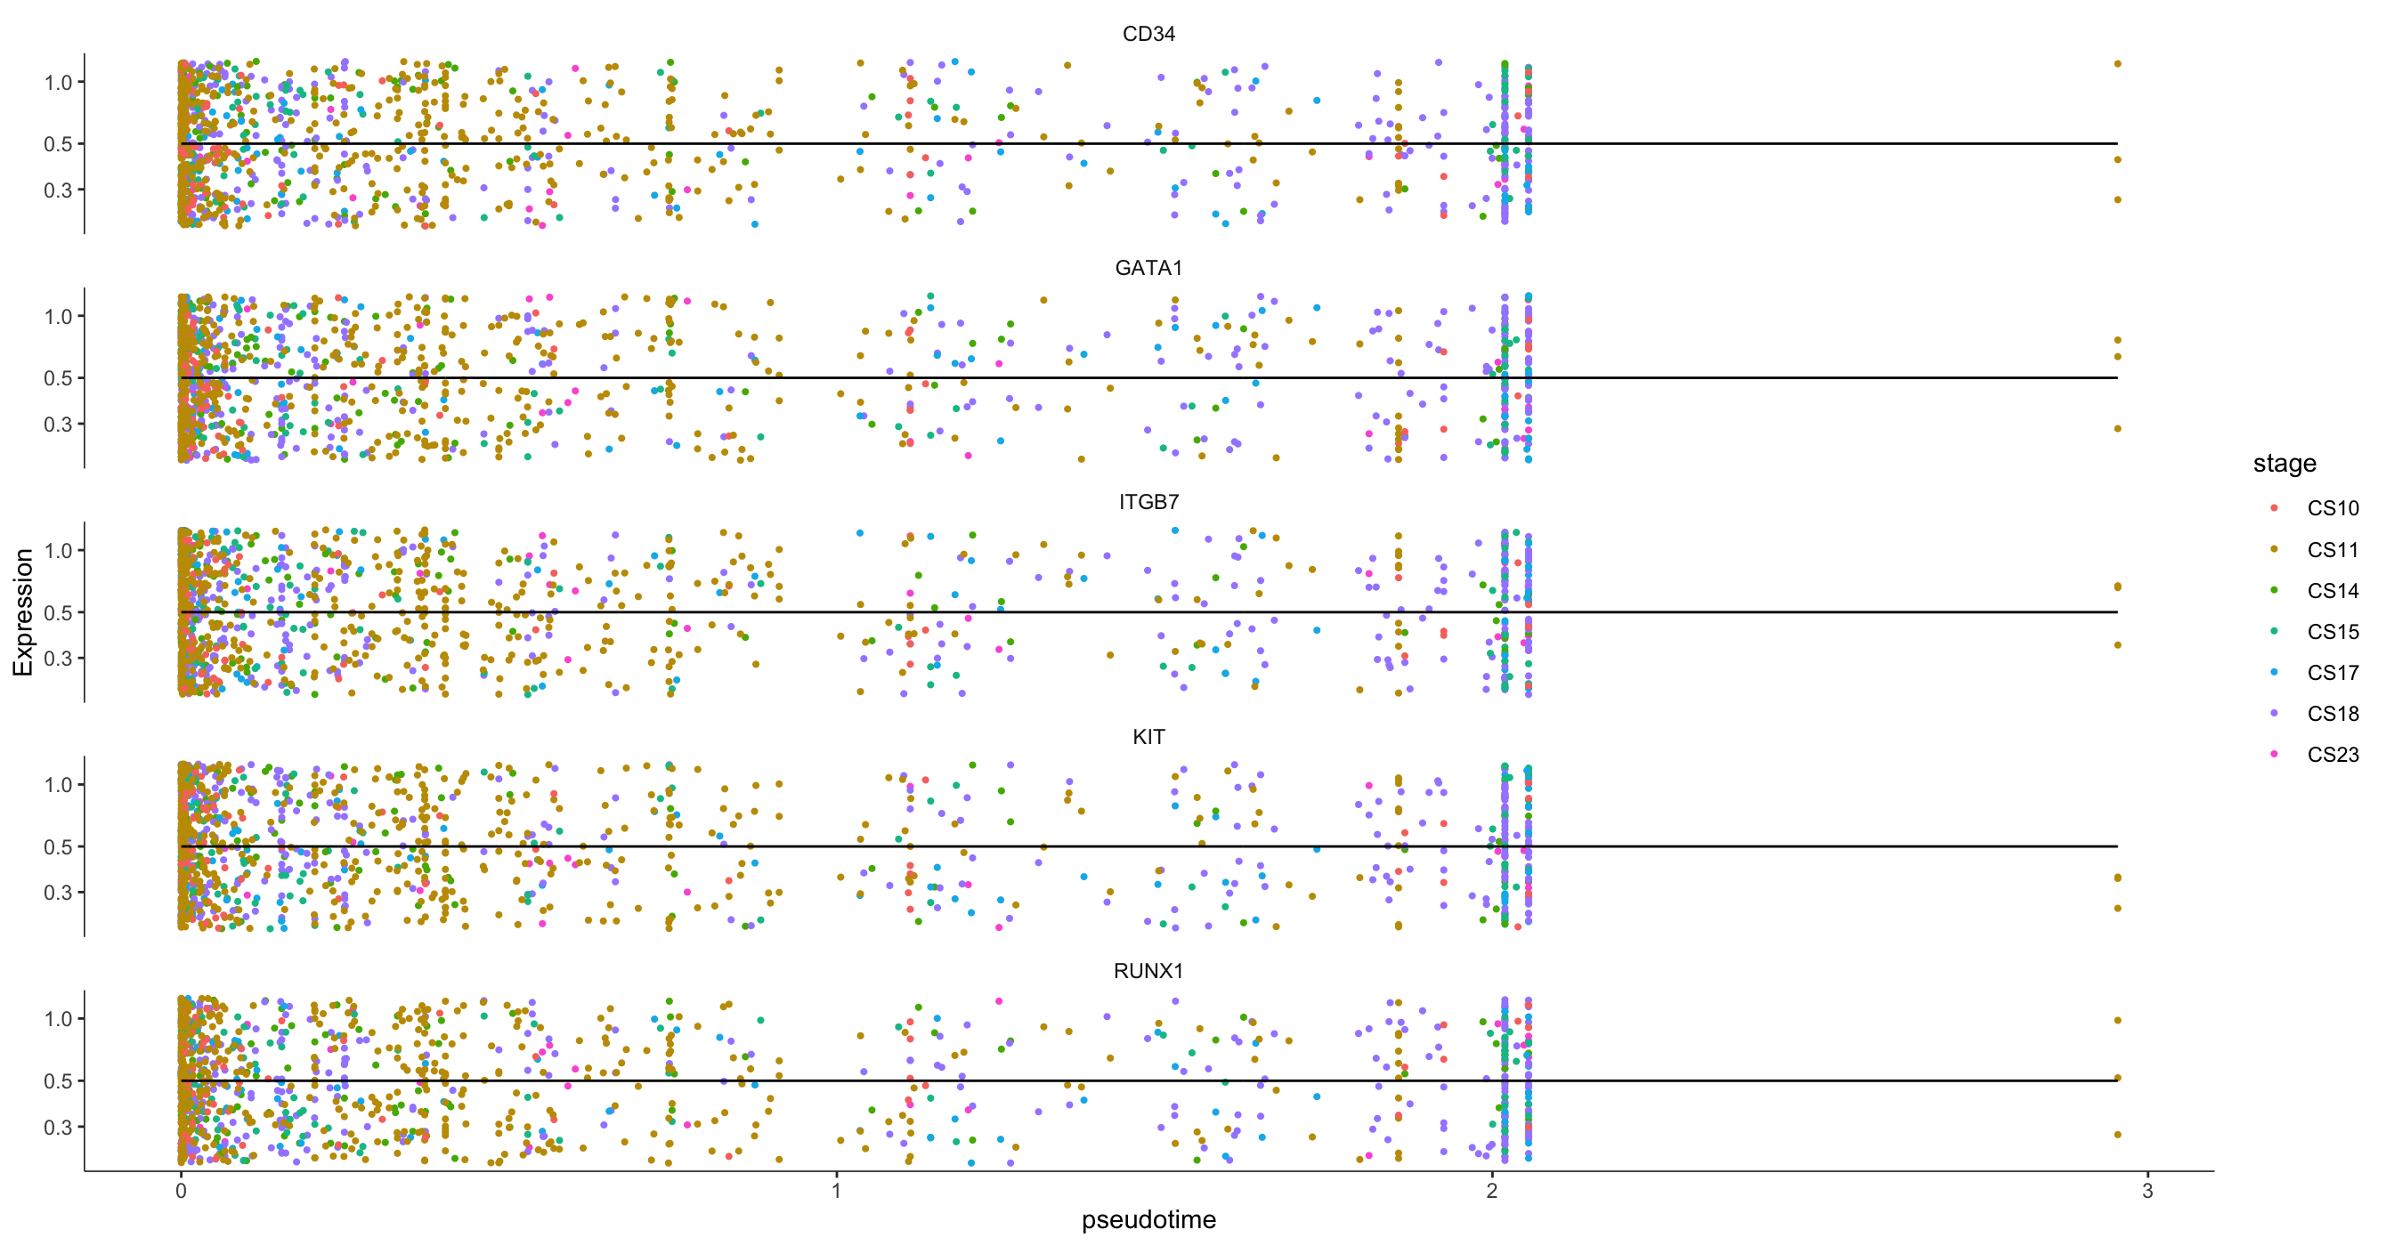
A
B

Slide 15
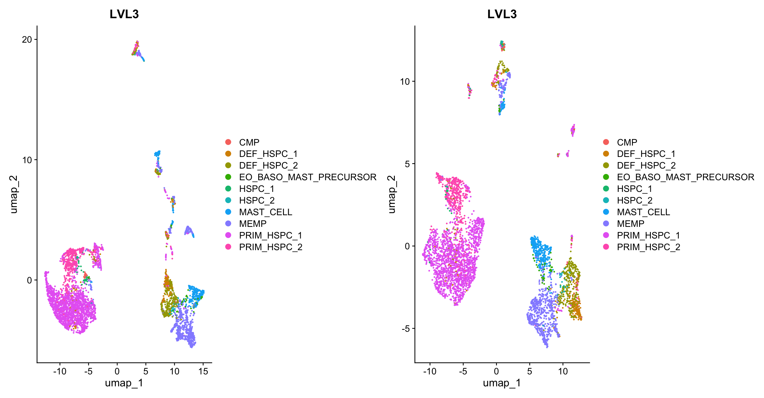
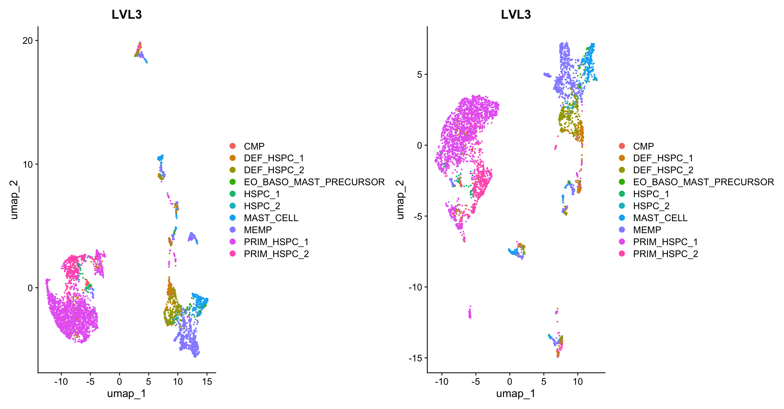
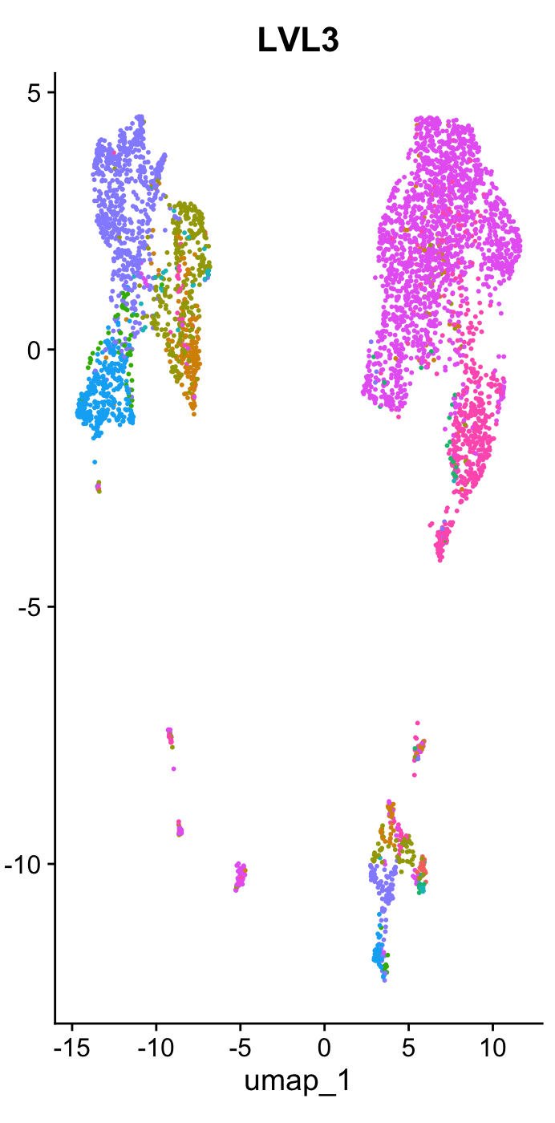
Integrated based on Component
Integrated based fetal.ids
Integrated based stage of Development
Not Integrated
A
B
C
D

Slide 17
Preprocessing
Differentially Expressed Genes
Quality Control
Normalization
Integration
→
Fill in
Fill in
Data Already Had Some QC Conducted
Harmony
+
→
+
Dimensionality Reduction
Or
→
Pseudotime Trajectory
Filtering Based on MT%, nCount, and nFeature
Seurat Anchors
→
Non-linear Dimensionality Reduction: UMAP
Cluster Cells
Comparison of Clusters
Trajectory Analysis
+
→
→
→
→
Clustering & Finding Neighbors

